Slide 1
HW1
1.9 Are natural languages capable of expressing algorithms?
答案：No, natural language is ambiguous, but algorithms require definiteness.
解析：关键是指出自然语言有二义性

Slide 2
HW2
2.40 Write the decimal equivalents for these IEEE floating point numbers.
c. 0 11111111 00000000000000000000000
答案：+INF
解析：注意32位浮点数的特殊情况

Slide 3
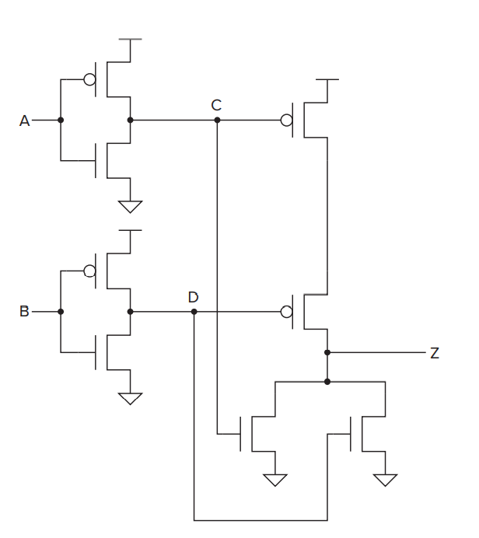
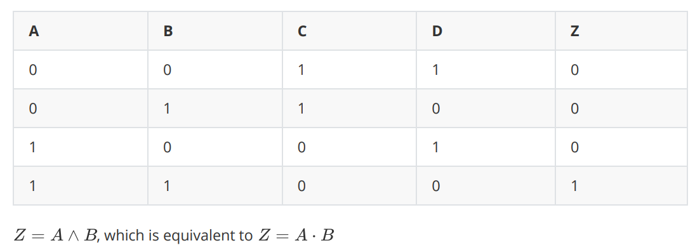
HW2
3.6 For the transistor-level circuit in Figure 3.38, fill in the truth table. What is Z in terms of A and B?
答案：如下图

Slide 4
HW2
3.20 How many output lines will a 16-input multiplexer have? How many select lines will this multiplexer have?
答案：output line = 1；select line = 4

Slide 5
HW3
3.38 Distinguish between a memory address and the memory’s addressability.

Slide 6
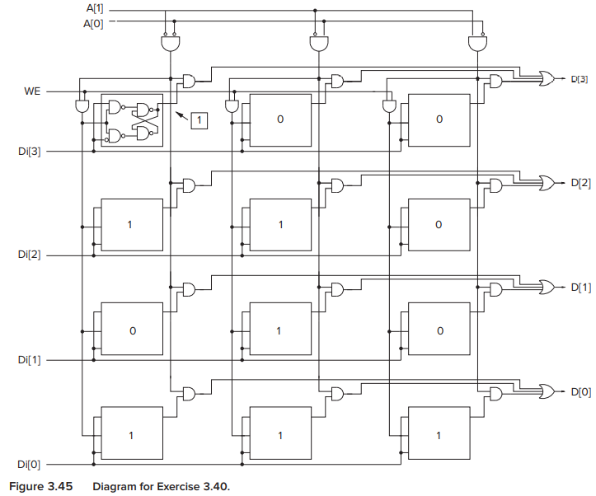
HW3
3.40 For the memory shown in Figure 3.45
What is the address space?
What is the addressability?
What is the data at address 2?
【解析】
1. 与图3.21区分。
2. Address space != location number

Slide 7
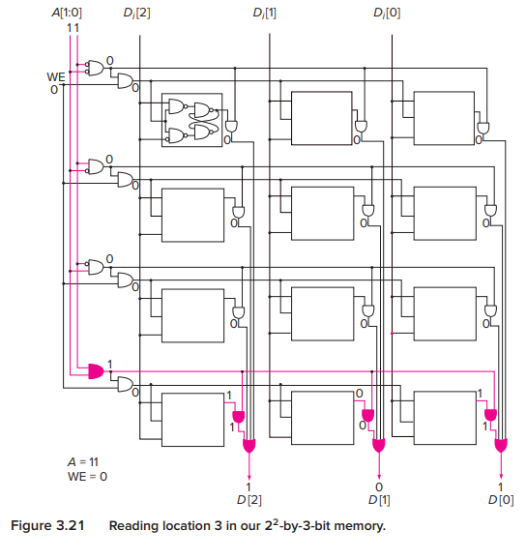
HW3

Slide 8
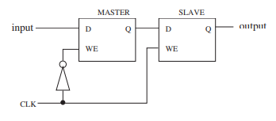
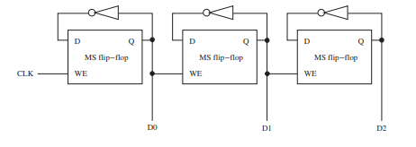
HW3
3.53 The master/slave flip-flop we introduced in the chapter is shown below. Note that the input value is visible at the output after the clock transitions from 0 to 1.
Shown below is a circuit constructed with three of these flip-flops.

Slide 9
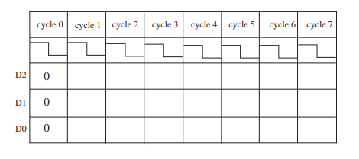
HW3
Fill in the entries for D2, D1, D0 for each of clock cycles shown.
In ten words or less, what is this circuit doing?
【解析】
这是一个自减计数器。

Slide 10
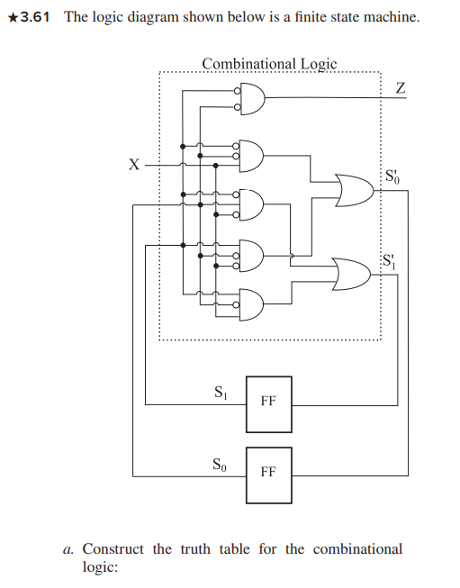
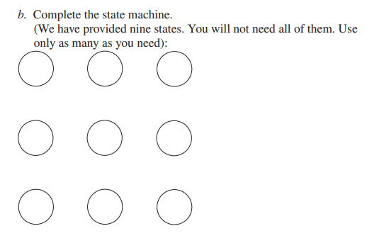
HW3
3.61

Slide 11
HW3
3.61
【解析】
1. 状态图的输出写在圆圈里还是曲线上
- 与输入相关时写在曲线上
- 与输入无关时写在圆圈里

Slide 12

HW3
4.1 Name the five components of the von Neumann model. For each component, state its purpose.
4.7 Suppose a 32-bit instruction takes the following format:
If there are 60 opcodes and 32 registers, what is the range of values that can be represented by the immediate (IMM)? Assume IMM is a 2’s complement value.

Slide 13

HW4
4.3 What is misleading about the name program counter? Why is the name instruction pointer more insightful?
4.8 Suppose a 32-bit instruction takes the following format:
If there are 225 opcodes and 120 registers,
What is the minimum number of bits required to represent the OPCODE?
What is the minimum number of bits required to represent the destination register (DR)?
What is the maximum number of UNUSED bits in the instruction encoding?

Slide 14
HW4
4.9 The FETCH phase of the instruction cycle does two important things. One is that it loads the instruction to be processed next into the IR. What is the other important thing?

Slide 15
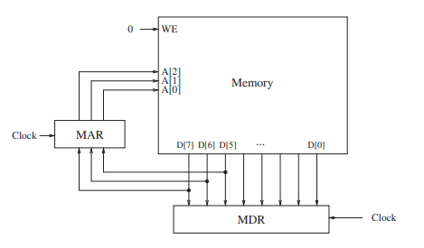
HW4
4.19 Shown below is a byte-addressable memory consisting of eight locations, and its associated MAR and MDR. Both MAR and MDR consist of flip-flops that are latched at the start of each clock cycle based on the values on their corresponding input lines. A memory read is initiated every cycle, and the data is available by the end of that cycle.

Slide 16
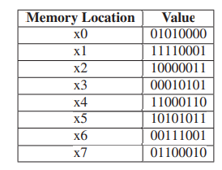
HW4
Just before the start of cycle 1, MAR contains 000, MDR contains 00010101, and the contents of each memory location is as shown.
What do MAR and MDR contain just before the end of cycle 1?
What do MAR and MDR contain just
before the end of cycle 1?
【解析】
1. before the end of cycle 1 ==
before the start of cycle 2.

Slide 17
HW4
5.1 Given instructions ADD, JMP, LEA, and NOT, identify whether the instructions are operate instructions, data movement instructions, or control instructions. For each instruction, list the addressing modes that can be used with the instruction.
【解析】
1. 5种寻址方式
Immediate
register
memory addressing mode
PC - relative
indirect
base + offset

Slide 18
HW4
5.4 Say we have a memory consisting of 256 locations, and each location contains 16 bits.
How many bits are required for the address?
If we use the PC-relative addressing mode, and want to allow control transfer between instructions 20 locations away, how many bits of a branch instruction are needed to specify the PC-relative offset?
If a control instruction is in location 3, what is the PC-relative offset of address 10? Assume that the control transfer instructions work the same way as in the LC-3.
【解析】
1. 第二问需要考虑符号位。
2. 第二问中，20locations表示地址之差为20，不是间隔20条指令。
3. 第二问需要把PC+1考虑在内。

Slide 19
HW4
5.9 We would like to have an instruction that does nothing. Many ISAs actually have an opcode devoted to doing nothing. It is usually called NOP, for NO OPERATION. The instruction is fetched, decoded, and executed. The execution phase is to do nothing! Which of the following three instructions could be used for NOP and have the program still work correctly?
a. 0001 001 001 1 00000
b. 0000 111 000000001
c. 0000 000 000000000
What does the ADD instruction do that the others do not do?
【解析】
a. ADD R1, R1, #0, it changes conditional codes
b. BRnzp #1
c. branch does not change PC

Slide 20
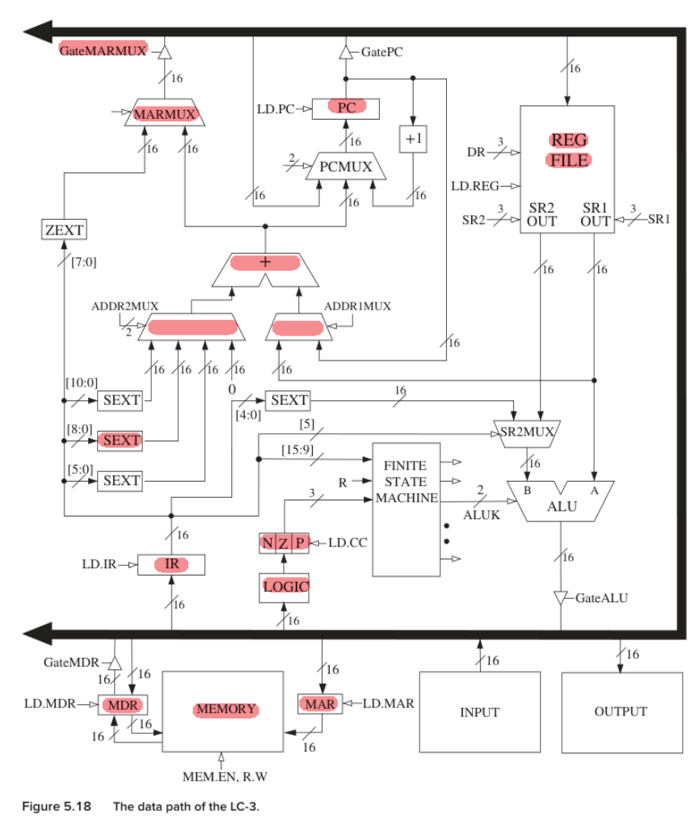
HW5
5.37
需要注意，LDI指令需要setcc，需要有nzp模块参与

Slide 21
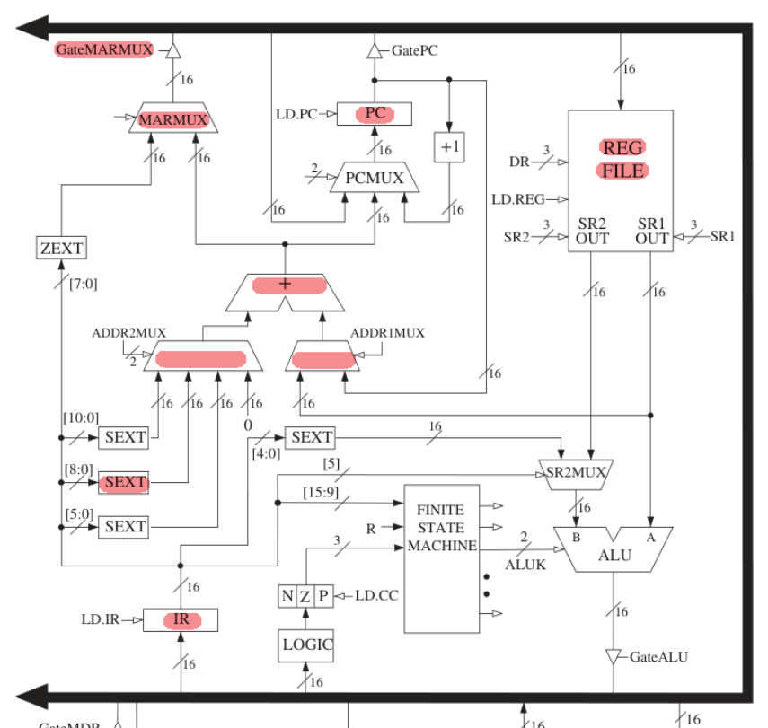
HW5
5.39
LEA 指令没有setcc，因此不能包含nzp

Slide 22
HW5
6.9， 6.10
没有太多问题
问题出在大家很多都没有认真审题，
这两题都是需要使用机器码的

Slide 23
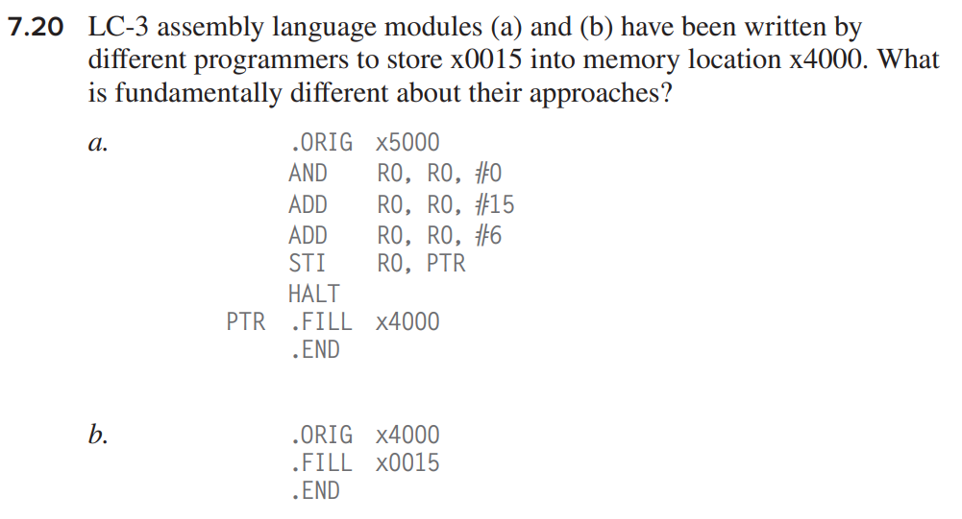
HW6
需要答出：
A是run time 存储，也就是说 只有在执行程序的时候完成存储的操作
B是在加载程序的时候完成的存储。程序还没真正执行的时候已经将内容加载到内存了

Slide 24
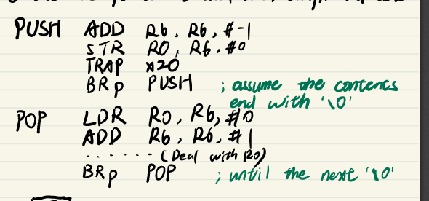
HW7
8.7
没有实现任意次数的push.pop
没有用循环

Slide 25
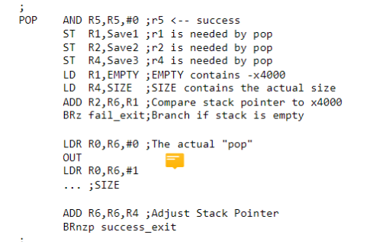
写代码可以用省略号？
万一size>31，要怎么办？。。。

Slide 26
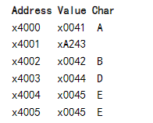
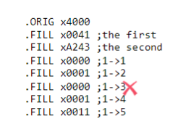
8.8 (b)
漏掉Push K
写成Push D和Push E
8.12
填地址，而不是ASCII或者数字

Slide 27
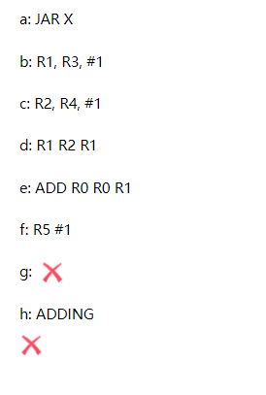
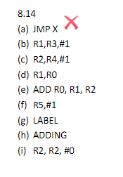
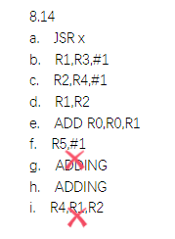
8.14
是JSR X, 而不是JMP X,或者BR X
LABEL和ADDING搞反
（i）填错

Slide 28

HW8
9.2
提及在同步IO控制下，I/O设备发出信号必须由处理器同时接受即可
不太准确的答案：
9.10
The display hardware may miss some characters we expect to show.

Slide 29


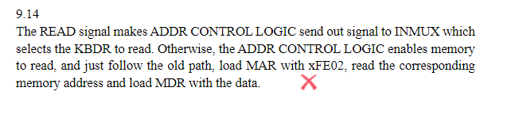
9.14
xFE02和KBDR就是映射关系，跟KBSR没有关系！

